Slide 1

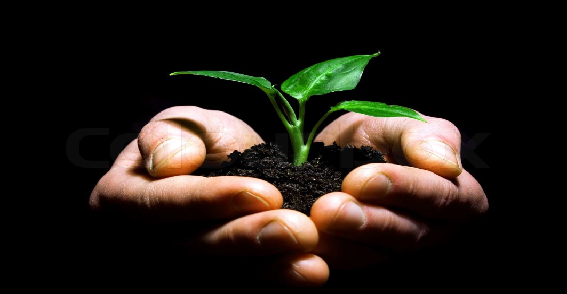
TITLE: Crop Guard: A Multi-Stage Disease Detection System along with Disease Classification for plants Using Machine Learning On Leaf Images
Team Members:
J. Aruna Bharathi
K. Samitha

Slide 2
Abstract:
Crop Guard is a sophisticated multi-stage plant disease detection system leveraging machine learning on leaf images. The system involves image acquisition, and preprocessing, and employs deep learning for disease identification and classification. Crop Guard goes beyond binary disease detection by assessing disease severity, unlike traditional systems. The core of Crop Guard lies in its machine learning-based disease detection and classification modules. We employ state-of-the-art deep learning architectures trained on a diverse dataset of plant diseases. The model is capable of identifying various diseases affecting plants, providing valuable insights into the specific type of infection present. This innovative approach provides farmers with actionable insights, empowering them to make informed decisions for effective disease management and crop protection. The user-friendly interface ensures accessibility for farmers, contributing to sustainable agriculture and food security. The machine learning model that we are using to detect the disease in the plant makes use of the Alex net algorithm to train the dataset. Our model not only detects the disease in the plant but also helps us in predicting the stage of the disease. So that farmers can make use of this to analyze the crop damage present.
Key Words:
Machine learning, Alex net, Image processing, Leaf, Disease

Slide 3
Problem Definition:
Our project addresses the critical issue of uncertainty in crop disease prediction within the agricultural sector.
Farmers often face challenges in accurately predicting the disease present in the crop, leading to resource inefficiencies and economic burdens.
By leveraging ML techniques and focusing on leaf images, we aim to reduce the risk factors associated with disease prediction.
The project’s core objectives include developing a predictive model that enhances accuracy in disease prediction outcome forecasts, optimizing resource utilization for cost savings, and promoting sustainable farming practices.
The scalability of our model, applicable from small-scale farms to large agricultural fields, is a key consideration.
Through data-driven decision-making, we aspire to empower farmers with valuable insights, contributing to informed and strategic choices.
Ultimately, our project strives to address global food security concerns by improving agricultural productivity, minimizing wastage, and fostering a more sustainable and resilient future for the agricultural sector

Slide 4
Social Significance :
The prospective for significant agricultural breakthroughs motivates the idea of developing a systemic agricultural system that anticipates crops.
This novel strategy promises greater agricultural yields and an increased supply of food, which is critical for meeting the world’s growing food needs.
This approach not only saves farmers money by optimizing resource use, but it also emphasizes sustainable farming practices.
Furthermore, this concept promotes decision-making based on data and can be scaled up to big agricultural fields from tiny gardens.
So, it promotes awareness and learning about agricultural sustainability while also encouraging innovation in farming operations.
Finally, it contributes to the global availability of food by increasing agricultural output while decreasing food waste.

Slide 5
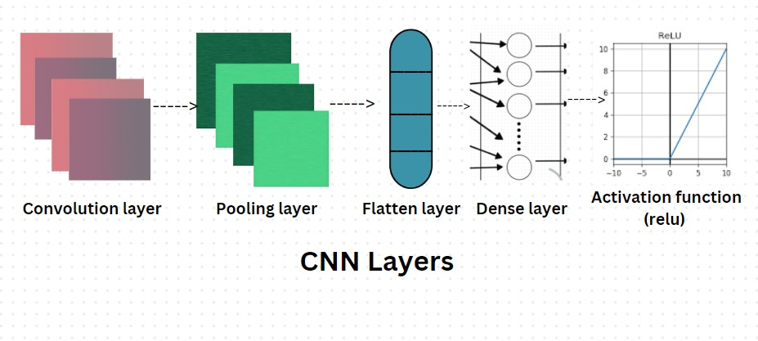
Model Architecture:

Slide 6
Methodology
Step 1: Data Collection
Collecting a comprehensive dataset that includes leaf images in different stages and other relevant agricultural information.
Step2: Importing the dataset
Importing the image dataset
Step3: Data Exploration and Preprocessing
Following data loading, a thorough exploration is conducted. This involves analyzing properties, addressing missing values, and preprocessing the data. Preprocessing may include tasks like argumentation and resizing.

Slide 7
Methodology
Obtain images of leaves from the crops.
Resize, arguments, and preprocess the captured leaf images.
Extract relevant characteristics from the preprocessed images.
Identify the type of disease affecting the leaves.
Determine the severity level of the identified disease (healthy, powdery, and rust).
Visualize the results, potentially using tools like confusion matrices.

Slide 8
KEY FEATURES
Leaf Image Analysis: The model takes leaf images as input and predicts the disease present in that particular crop.
Disease Detection: Employing machine learning algorithms, Leaf Guard accurately detects the presence of diseases in plants, contributing to early diagnosis.
Multi-Stage Classification: Beyond binary identification, the model classifies diseases into different stages, offering a nuanced understanding of the severity of the infestation.
User-Friendly Interface: Leaf Guard incorporates a user-friendly interface, making it accessible to farmers and agricultural professionals, fostering seamless integration into existing agricultural practices.

Slide 9
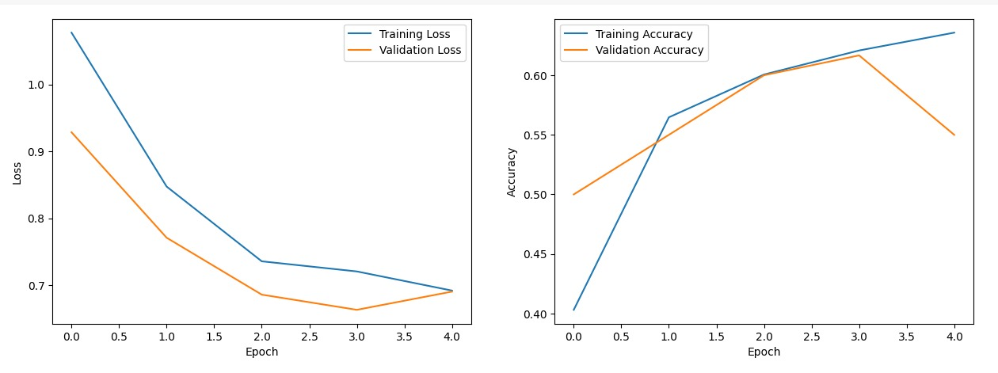
Result Analysis
Assess model performance on test set using metrics like accuracy, precision, recall for effective evaluation.
Save the trained model for deployment, document the entire training process, and consider future refinements for continuous improvement.

Slide 10
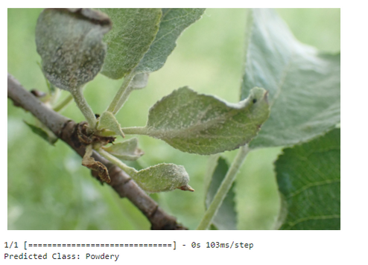
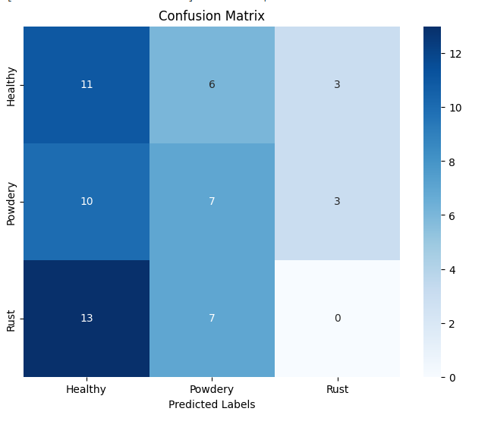
Result Analysis
The model accurately graded disease severity levels, offering a nuanced understanding crucial for targeted and timely interventions, ultimately minimizing crop losses.
The trained model demonstrated impressive accuracy, outperforming traditional methods, and exhibited high precision in correctly identifying diseased and healthy leaves.
Test Accuracy:
for the level of disease detection-95%

Slide 11
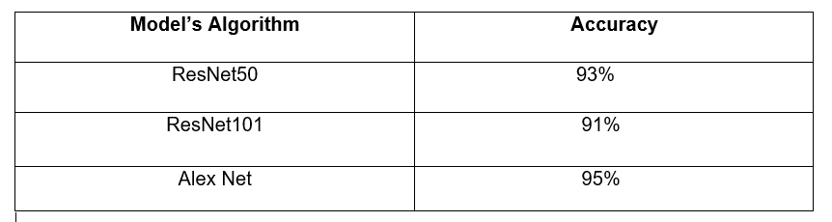
Trained models

Slide 12
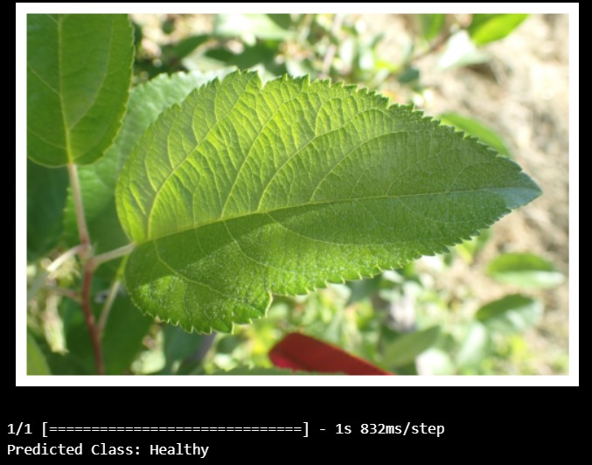
Conclusion:
Key findings:
Input Output
Further direction:
Further research is encouraged to develop deeper into the causes and economic impact of the farming practices, as well as strategies for improving the yield.
Commitment:
We strive for better accuracy.
Our main moto is to increase the yield in farming.

Slide 13
Thank you

